Slide 1
Pi Bracket to Mount to Wood

Slide 2
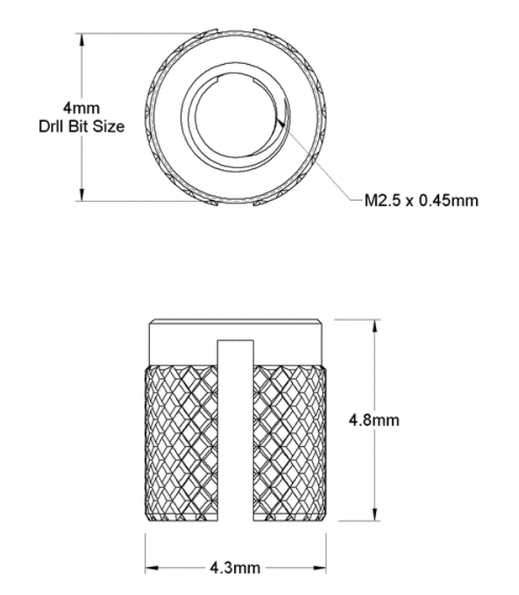
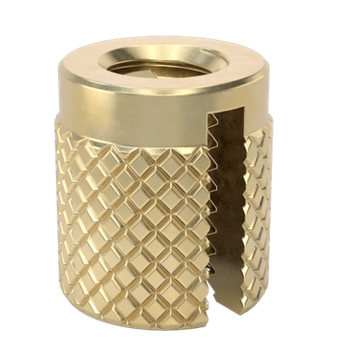
M2.5 Thread Insert
https://www.mcmaster.com/94510A612/

Slide 3
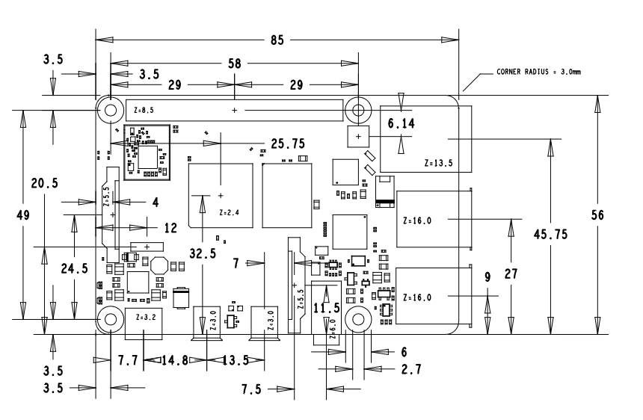
Pi 4 mechanical drawing

Slide 4
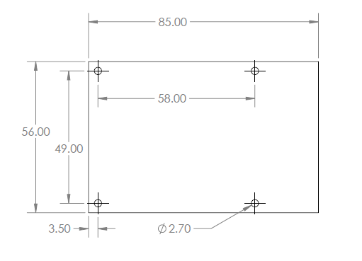
Simplified Pi 4 holes and board dimensions

